Slide 1
Year 4
Online vs face-to-face communication

Slide 2
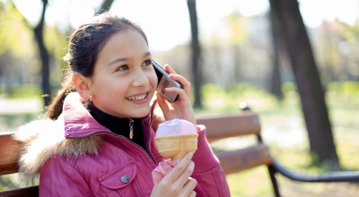
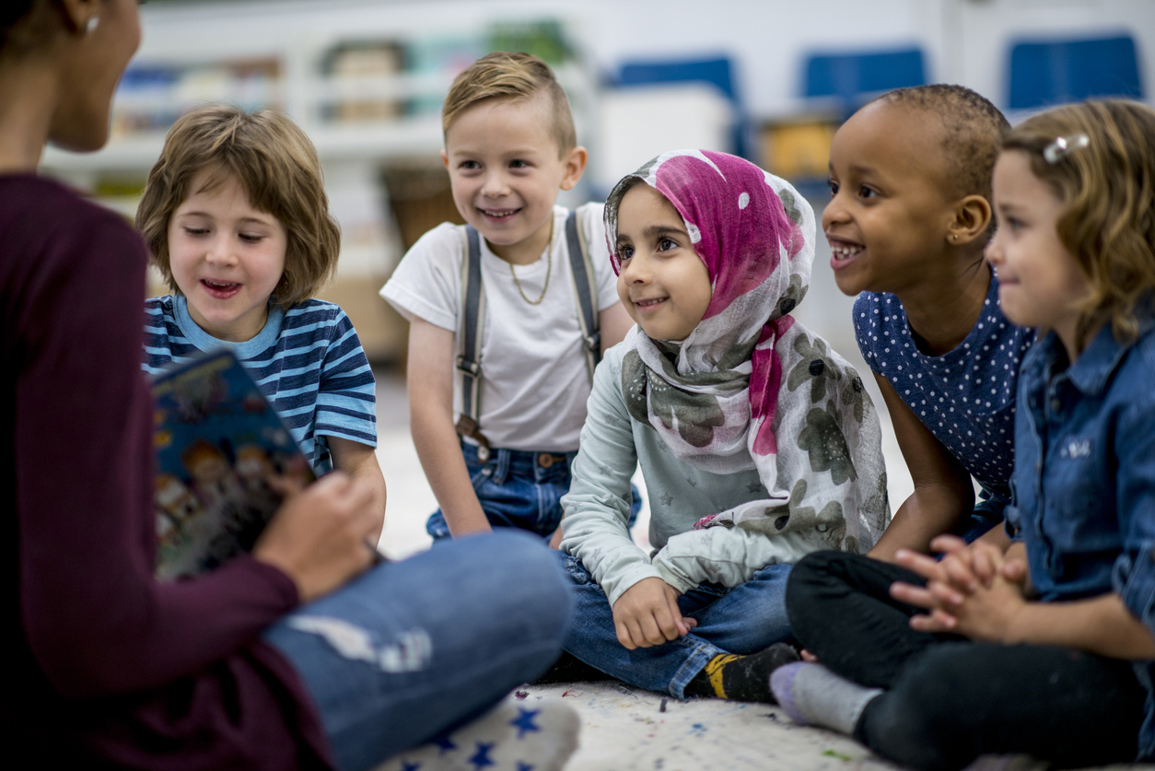
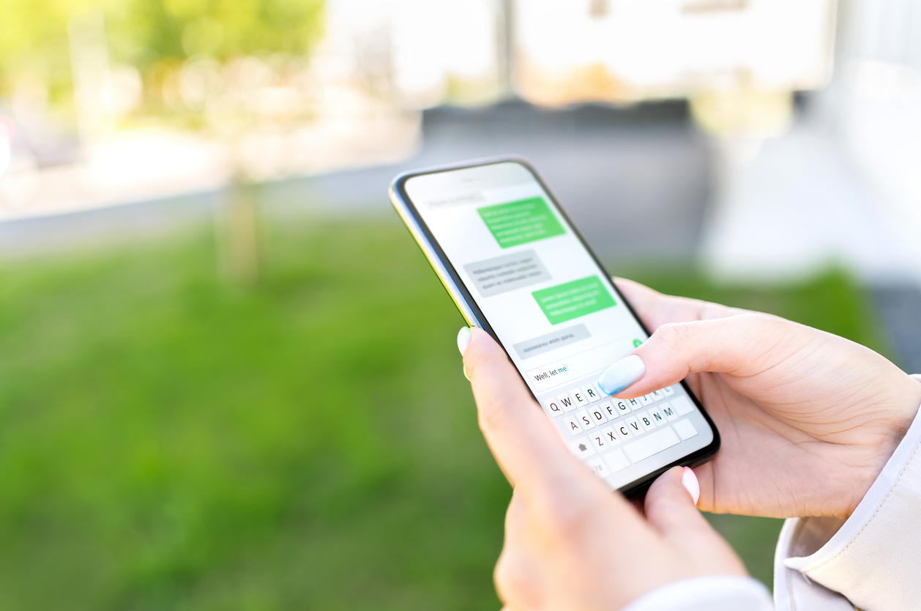
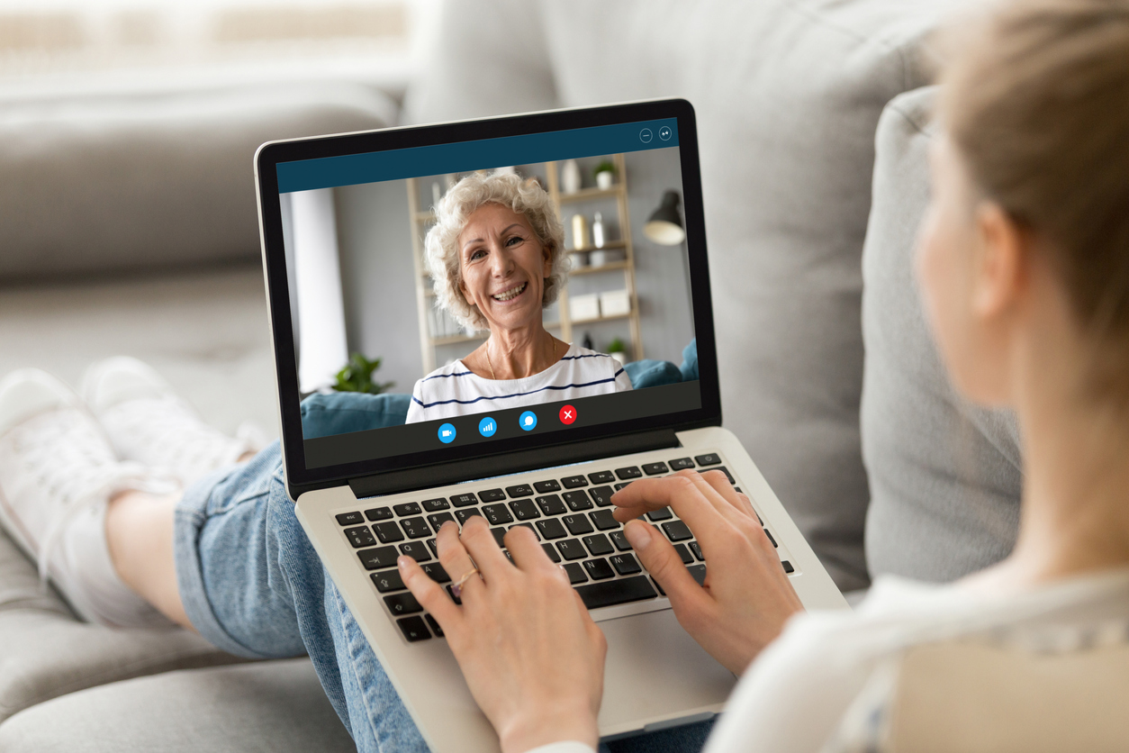
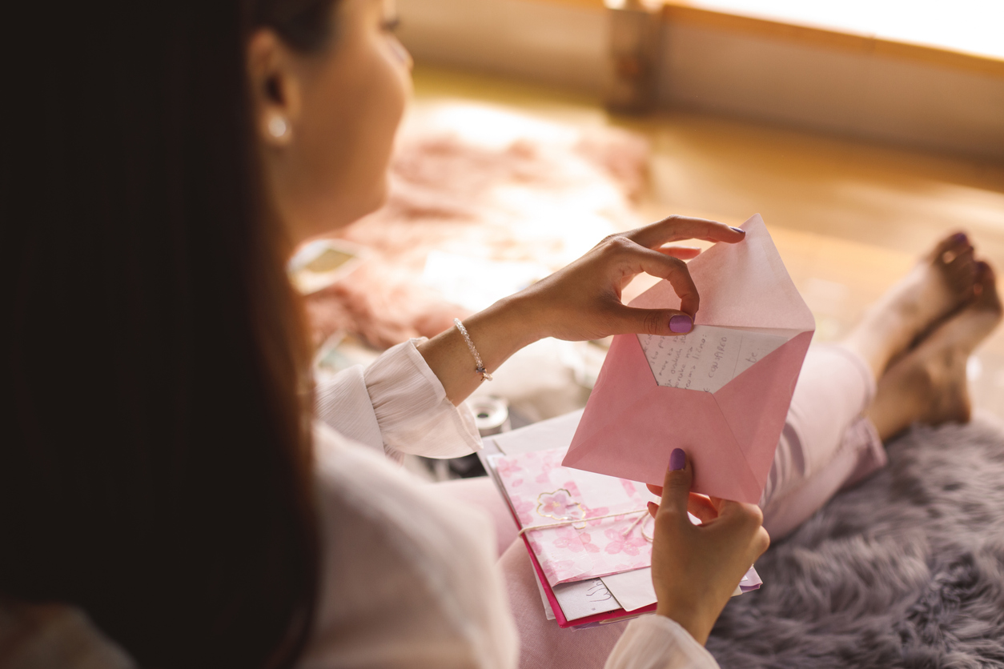
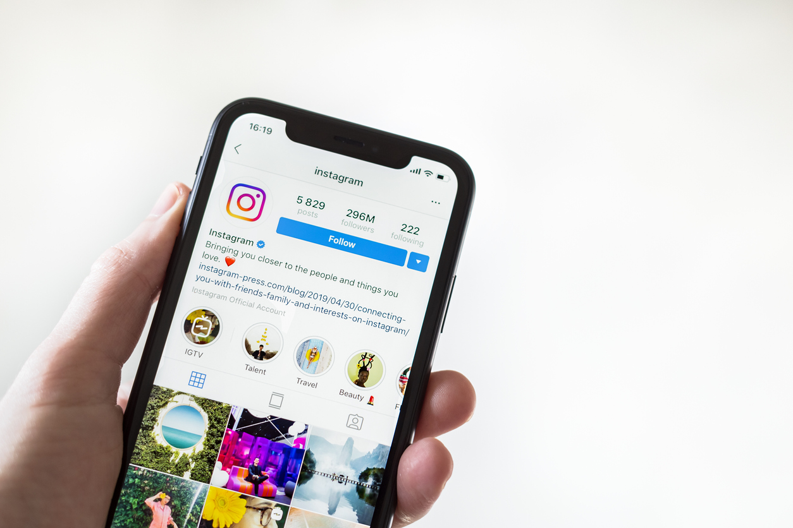

Slide 3
Guess my category

Slide 4
 | Positives | Challenges
Text only
Photos
Videos
Face-to-face

Slide 5
Everyone thinks Mr B is so funny!
I just can’t take this anymore.
Why do you want to go to her house?
1
2
3
I don’t know!
Stop it!
I don’t care.
4
5
6

Slide 6
1.
Sharing some bad news with a friend.
2.
Needing to tell a friend urgently about a change of plans about a pick up time.
3.
You got an amazing present for your birthday and wanted to show your friend.
4.
You had a fight with your best friend and want to apologise.
5.
Wishing Grandad a happy birthday.
6.
Announcing that you are going to be a big brother/sister.
Stop it!

